Slide 1
ACCURATE AUTO TITLE SPECIALISTS LLC aka Cindy Titles 303-919-0775 cindytitles@yahoo.com

Slide 2
COLORADO AUTOMOBILE DEALERS ASSOCIATION
Tim Jackson - CMP, CAE CEO/President
Matthew Groves - Vice President of Legal, Regulatory & Compliance
Kim Jackson - Marketing & Communications Director
290 E. Speer Blvd.
Denver, CO 80203
Phone: 303.831.1722 Fax: 303.831.4205
https://www.colorado.auto

Slide 3
INSTRUCTOR
Cindy Vieyra – Owner
20+ years experience ~ 10+ years in business ~
5+ years training
Accurate Auto Title Specialists LLC
aka Cindy Titles
303 -919-0775
cindytitles@yahoo.com

Slide 4
We will never know if people are doing the best they can or not.
I will simply believe all people ARE doing the best they can.
MY life will be better! ~ Brene Brown
“People will forget what you said. People will forget what you did.
People will never forget how you made them feel” ~ Maya Angelou

Slide 5
State 1881 Pierce St Lakewood 303-205-5600
Make appointment to drop off docs or make an appointment for Record Searches at the counter.
Someone from the title division calls when docs are ready.
Schedule an appointment to pick up.
2 – 3+ weeks out
___________________________________________________________________________________________________________________________________________________________________________________________________________________________________________________________________________________________________________

Slide 6
State 1881 Pierce St Lakewood 303-205-5600 The offices of the Department of Revenue, Division of Motor Vehicles at 1881 Pierce Street, Lakewood, Colorado, 80214 are open to the public by appointment only https://www.colorado.gov/pacific/dmv/AppointmentScheduling

Slide 7
ADDITIONAL INFORMATION
____________________________________________________________________________________________________________________________________________________________________________________________________________________________________________________________________________________
303-919-0775 cindytitles@yahoo.com

Slide 8
ADAMS COUNTY 720-523-6310 CUSTOMER INFO TUESDAY – FRIDAY **
Processing Titles
Need to process a title without coming in, or need to get a temporary plate?
We’ve updated our process so you can handle it via secure email!
Processing a title can include, but are not limited to, transactions such as:
A new purchase
Purchase of a used vehicle
Removing lienholder from a title
Adding a new lien
Purchase vehicle at end of lease
Moving to Colorado with your out-of-state title
Removing or adding a name to your title
Correcting information on your title
The forms are not savable. Once you’ve identified the correct form, download it (if necessary), fill it in, print it out, sign it, scan it, and email it to MVTitles@adcogov.org with all supporting ownership documents.
New Resident
Out-of-State Cash Sale
Private Party Sale with Colorado Title
Purchase for Cash from a Colorado Dealer
If you’re unsure of which form you need, reach out to our Motor Vehicle Titles Center at 720.523.6310. Their hours are Tuesday-Friday, 7 a.m. - 5:30 p.m. The last call will be taken at 4:30 p.m. In-person visits require an appointment that can be scheduled online or over the phone.
____________________________________________________________________________________________________________________________________________________________________________________________________________________________________________________________________________________________________________________________________________________________________________________________________________________________________
______________________________________________________________________________________________________________________________________________________________________________________________________________________________________________________________________________________________________________________________________________________________________________________________________________________________________________________________________________

Slide 9
ADAMS COUNTY 720-523-6310 DEALER INFO TUESDAY – FRIDAY **
Currently, there is a limit of one transaction per appointment.
Anything in excess will need to be mailed to the Brighton Motor Vehicle office or scheduled in a 10-minute, drop-off appointments. Appointments can be scheduled online.
Brighton Motor Vehicle: 4430 South Adams County Parkway Suite, E2001 Brighton, CO 80601
Email us at mvservicecenter@adcogov.org
________________________________________________________________________________________________________________________________________________________________________________________________________________________________________________________________________________________________________________________________________________________________________________________________________________________________________________________________________________________________________________________________________________________________________________

Slide 10
ADDITIONAL INFORMATION / QUESTIONS
____________________________________________________________________________________________________________________________________________________________________________________________________________________________________________________________________________________
303-919-0775 cindytitles@yahoo.com

Slide 11
ARAPAHOE COUNTY 303-795-4500 CUSTOMER INFORMATION
COVID-19 Service Update
In-person hours of service are available by appointment only and can be made for all our Motor Vehicle/Administration branches (Littleton, Centennial, Aurora, and Byers).
Appointments are available Monday-Friday, 7 a.m. – 4 p.m. and can be made online for:
Motor Vehicle registration, license plates and motor vehicle titles
Make an Appointment
________________________________________________________________________________________________________________________________________________________________________________________________________________________________________________________________________________________________________________________________________________________________________________________________________________________________________________________________________________________________________________________________________________________________________________________________________________________________

Slide 12
ARAPAHOE COUNTY 303-795-4500 DEALER INFORMATION
SCHEDULE AN APPOINTMENT
https://qw-arapahoe.us.qmatic.cloud/qwebbook/index.html#/
Dealer Drop-offs (For Dealers only - Must provide Dealer License Number)
________________________________________________________________________________________________________________________________________________________________________________________________________________________________________________________________________________________________________________________________________________________________________________________________________________________________________________________________________________________________________________________________________________________________

Slide 13
ADDITIONAL INFORMATION
____________________________________________________________________________________________________________________________________________________________________________________________________________________________________________________________________________________
303-919-0775 cindytitles@yahoo.com

Slide 14
BOULDER COUNTY 303.413.7710 Monday through Friday from 8 a.m. – 4:30 p.m. Customer
Boulder County Motor Vehicle Offices are Open –
Appointments recommended
NO OPTION TO MAKE APPOINTMENT FOR DEALER –
MAIL IN DOCUMENTS
________________________________________________________________________________________________________________________________________________________________________________________________________________________________________________________________________________________________________________________________________________________________________________________________________________________________________________________________________________________________________________________________________________________________________________________________________________________________________________________________________________________________________________________________________________________________________________________________________________________________________________________________________________________________________________________________________________________________________________________________________________________________________________

Slide 15
ADDITIONAL INFORMATION
____________________________________________________________________________________________________________________________________________________________________________________________________________________________________________________________________________________
303-919-0775 cindytitles@yahoo.com

Slide 16
DENVER COUNTY Customers 7 a.m. - 3:30 p.m. M, Tu, Th, F 7:30 a.m. - 3:30 p.m. Wed.
All Denver Motor Vehicle locations are currently experiencing heavy customer traffic.
Customers are strongly encouraged to complete transactions online, by mail, by phone or via drop boxes at each branch location when possible.
If you require an in-person visit, please bring a cell phone or other text capable device to allow DMV staff to text you when it is your turn to safely enter the building
________________________________________________________________________________________________________________________________________________________________________________________________________________________________________________________________________________________________________________________________________________________________________________________________________________________________________________________________________________________________________________________________________________________________________________________________________________________________

Slide 17
DENVER COUNTY DEALERS 2855 Tremont between the hours of 8am and 4pm.
The automobile industry window will conduct immediate emergency title applications processing when there is less than 2 weeks remaining on a buyer’s temporary permit, however, there is a limit of
5 transactions per runner
________________________________________________________________________________________________________________________________________________________________________________________________________________________________________________________________________________________________________________________________________________________________________________________________________________________________________________________________________________________________________________________________________________________________________________________________________________________________

Slide 18
ADDITIONAL INFORMATION
____________________________________________________________________________________________________________________________________________________________________________________________________________________________________________________________________________________
303-919-0775 cindytitles@yahoo.com

Slide 19
DOUGLAS COUNTY Customer
Online Customer Service: mydmv.colorado.gov • MVExpress Kiosks: Registration Renewal/License Plate Tabs on the spot! Click here for locations and information • Customer Service by Mail: 9350 Heritage Hills Cir Lone Tree, CO 80124 • Customer Service by Email: DCMV@douglas.co.us • Customer Service by Phone: 303-660-7440, Monday – Friday, 9 a.m. – 4 p.m. Schedule an appointment for available in-person services
________________________________________________________________________________________________________________________________________________________________________________________________________________________________________________________________________________________________________________________________________________________________________________________________________________________________________________________________________________________________________________________________________________________________________________________________________________________________________________________________________________________________________________________________________________________________________________________________________________________________________________________________________________________________________________________________________________________________________________________________________________________________________________________________________________________________________________________________________________________________________________________________________________________________________________________________________________________________________________________________________________

Slide 20
DOUGLAS COUNTY DEALER · (303) 660-7440
No dealer appointments
Currently about 5-6 weeks out
Mail to the Lone Tree office 9350 Heritage Hill Cir Lone Tree, Co 80124
Drop box available. Not separate for dealers.
__________________________________________________________________________________________________________________________________________________________________________________________________________________________________________________________________________________________________________________________________________________________________________________________________________________________________________________________________________________________________________________________________________________________________________________________________________________________________________________________________________________________________________________________________________________________________________________________________________________________________________________________________________________________________________________________________________________________________________________________________________________________________________________________________________________________________

Slide 21
ADDITIONAL INFORMATION
____________________________________________________________________________________________________________________________________________________________________________________________________________________________________________________________________________________
303-919-0775 cindytitles@yahoo.com

Slide 22
JEFFERSON COUNTY DEALERS
Dealers
Dealers must make an appointment to drop off title work in person at our Golden office using the link below:
https://www.signupgenius.com/go/805094CA5AF22A4F58-golden
Dealers may drop paperwork off at the Arvada location using the drop slot.
We are allowing Dealers to pick up dropped-off paperwork at our Golden location only.
We will call you when the paperwork is ready to be picked up or you may request to have it mailed to you.
LIEN STAMPS – DROP WITH RETURN PRE-PAID ENVELOPE- RECEIVE THE DOCS WITHIN 2 DAYS – is not county specific
__________________________________________________________________________________________________________________________________________________________________________________________________________________________________________________________________________________________________________________________________________________________________________________________________________________________________________________________________________________________________________________________________________________________________________________________________________________________________________________________________________________________________________________________________________________________________________________________________________________________________________________________________________________________________________________________________________________________________________________________________________________________________________________________________________

Slide 23
JEFFERSON COUNTY CUSTOMER
Live Chat Click the green chat icon during business hours.
Call Center 303-271-8100 **The fastest way to get assistance is to use the live chat option above
Walk ins From 7:30 a.m. - 11:30 a.m., Monday - Thursday we will be accepting a limited number of walk ins for titling, new vehicle registration, and handicap placards at some of our offices: Arvada, Evergreen, Lakewood, and Littleton. (Please note that our Golden office will not be accepting walk-in customers.)
Appointments
We have an extremely limited number of appointments available only for those customers who must come in person
____________________________________________________________________________________________________________________________________________________________________________________________________________________________________________________________________________________________________________________________________________________________________________________________________________________________________________________________________________________________________________________________________________________________________________________________________________________________________

Slide 24
JEFFERSON COUNTY
LIEN STAMPS –
DROP WITH RETURN PRE-PAID ENVELOPE- RECEIVE THE
DOCS WITHIN 2-3 DAYS – is not county specific
____________________________________________________________________________________________________________________________________________________________________________________________________________________________________________________________________________________________________________________________________________________________________________________________________________________________________________________________________________________________________________________________________________________________________________________________________________________________________

Slide 25
Questions/additional information
____________________________________________________________________________________________________________________________________________________________________________________________________________________________________________________________________________________
303-919-0775 cindytitles@yahoo.com

Slide 26
WELD COUNTY CUSTOMER – DEALER
In-Person Transactions by appointment are only available if your transaction cannot be completed online, phone, or by email.
Who must make an appointment?
Private party sales (Individual to Individual)
Assigned VIN
Manufactured Homes
Government Vehicles
IRP title work (TVW)
TVW & GVW title work & plates
Bond
SMM
Dealer Title
Dealer Courtesy
Dealer Cash deals
Business
Homemade Trailers
Mail Hold
Permits for Out of State travel ONLY
Please call 970-304-6520 to make an appointment
Office Hours: 8:00 a.m. to 5:00 p.m.
OR CAN MAKE AN APPOINTMENT ON LINE FROM WEBSITE
____________________________________________________________________________________________________________________________________________________________________________________________________________________________________________________________________________________________________________________________________________________________________________________________________________________________________________________________________________________________________________________________________________________________________________________________________________________________________________________________________________________________________________

Slide 27
ADDITIONAL INFORMATION
____________________________________________________________________________________________________________________________________________________________________________________________________________________________________________________________________________________
303-919-0775 cindytitles@yahoo.com

Slide 28
ELPASO COUNTY
APPOINTMENT
Appointments scheduled for the incorrect service will NOT be honored. Per the Governor’s Executive Order you must wear a face mask in our offices.
** NO OPTION FOR DEALERS
General Motor Vehicle Information: 719-520-6240 motorvehicledept@elpasoco.com
Main Office: 1675 West Garden of the Gods Road Colorado Springs, CO 80907
________________________________________________________________________________________________________________________________________________________________________________________________________________________________________________________________________________________________________________________________________________________________________________________________________

Slide 29
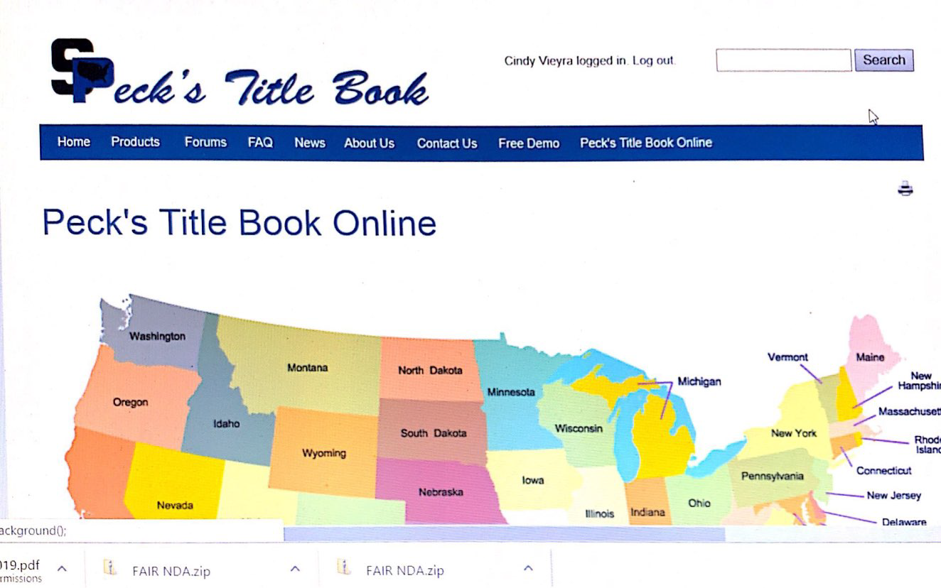
OUT OF STATE DMV
Most DMV offices are by appointment only.
Some DMV employees are working from home
Time frame can be up to 4-6 weeks to obtain documents
Strongly suggest contacting the state you are sending the documents to.
____________________________________________________________________________________________________________________________________________________________________________________________________________________________________________________________________________________________________________________________________________________________________________________________
________________________________________________________________________________________________________________________________________________________________________________________________________________________________________________________________________________________________________________________________________________________________________________________________

Slide 30
USEFUL INFO Example letter to file lien on out of state purchase
________________________________________________________________________________________________________________________________________________________________________________________________________________________________________________________________________________________________________________________________________________________________
cindytitles@yahoo.com

Slide 31
ADDITIONAL INFORMATION
____________________________________________________________________________________________________________________________________________________________________________________________________________________________________________________________________________________
303-919-0775 cindytitles@yahoo.com

Slide 32
USEFUL INFO POWER OF ATTORNEY SECURE AND VERIFIABLE REQUIREMENTS
POWER OF ATTORNEY SECURE AND VERIFIABLE
IDENTIFICATION REQUIREMENTS
• Secure and Verifiable Identification requirements are the same for all power of attorney forms; Secure, Non-Secure, Military or General.
• The Secure and Verifiable Identification of the grantor (the person granting the Power of Attorney) is required to be recorded either on the Power of Attorney or the
DR 2842 Supplemental Identification Form.
The agent (the person granted power of attorney) will be required to present Secure and Verifiable Identification when the agent has been appointed the power to:
* Apply for and take receipt of an original certificate of title on behalf of the Grantor.
*Apply for and take receipt of a new registration on behalf of the Grantor. Apply for and take receipt of a new temporary registration on behalf of the Grantor.
* Apply for and take receipt of a duplicate title with an issue date on or after July 1, 2006 on behalf of the Grantor.
*The Secure and Verifiable Identification is not required for the grantor or for their agent when the agent has been appointed the power to:
* Record or release a lien.
* To transfer ownership and acknowledge odometer reading.
COLORADO TITLE & REGISTRATION MANUAL JULY, 2020 Page 273
Always attach a DR2842(secure and verifiable) for grantor of the POA
________________________________________________________________________________________________________________________________________________________________________________________________________________________________________________________________________________________________

Slide 33
Order of Documents to County
APPLICATION DR 2395
TITLE / MSO
BOS in order of assignments
POA’S in order of assignments
Supporting documents
Security agreement
DR 0024 or DR 0026
CHECK
FROM DOUGLAS COUNTY TRAINER LESLIE CURRAN

Slide 34
ADDITIONAL INFORMATION
____________________________________________________________________________________________________________________________________________________________________________________________________________________________________________________________________________________
303-919-0775 cindytitles@yahoo.com

Slide 35
The number 1 Title Issue
Once a Colorado title is ISSUED the odometer reading cannot be corrected even with backing documents
Unless it’s a County “Typo”
This is an issue for EVERYONE;
Dealer title processors
county clerks
and individuals.

Slide 36
USEFUL INFORMATION
A single owner can now assign a beneficiary
FORM DR 2009

Slide 37
USEFUL INFO
CARFAX OR AUTOCHECK IS A POWERFUL TOOL
Search for title numbers
Last state vehicle
was titled in
(INCLUDES TITLE NUMBERS)
Branded titles
_______________________________________________________________________________________________________________________________________________________________________________________________

Slide 38
Useful links
https://www.colorado.gov/pacific/dmv/locations
https://www.colorado.gov/pacific/dmv/AppointmentScheduling
https://www.colorado.gov/pacific/dmv/forms-vehicles
CARFAX OR AUTOCHECK ~ Search for title numbers
Last state vehicle was titled in
Branded titles
DR1002 HOME RULE
YOU CAN “CONTROL FIND” IN HOME RULE CITIES DOCUMENT
State of Colorado Tax Division City and County Tax Specialist 303-205-6828

Slide 39
http://www.peckstitlebook.

Slide 40
CALIFORNIA CONTACT
CHELLE IS AMAZING!
________________________________________________________________________________________________________________________________________________________________________________________________________________________________________________________________________________________________________________________________________________________________________________________________________________________________________________________________________________________________________________________________________________________________________________

